Slide 1

FLIGHT PRICE PREDICTION USING MACHINE LEARNING
-Yash Bhardwaj

Slide 2
Outline
Introduction (Problem Statement and Review of Literature)
Dataset Information
Data Pre-processing and Visualization
Building Models
Best Model
Conclusion

Slide 3

Introduction
Anyone who has booked a flight ticket knows how unexpectedly the prices vary. The cheapest available ticket on a given flight gets more and less expensive over time. This usually happens as an attempt to maximize revenue based on –
1. Time of purchase patterns (making sure last-minute purchases are expensive)
2. Keeping the flight as full as they want it (raising prices on a flight which is filling up in order to reduce sales and hold back inventory for those expensive last-minute expensive purchases)
Problem Statement
We need to build machine learning models predicting the fare of the flights based on several features.

Slide 4
Review of literature
According to Y. Chen et al. (2015) , predicting the actual ticket price is a more difficult task than predicting an optimal ticket purchase time due to various reasons.
The higher the level of competition, the weaker of the market power of an airline, & then the less likely the chance of the airline fare increases.
Tziridis et al. In his comparison, Bagging Regression Tree is identified as the best model, which is robust and not affected by using different input feature sets.
The presence of LCC in a market has had a substantial impact on the total passenger volume and the air ticket price.

Slide 5
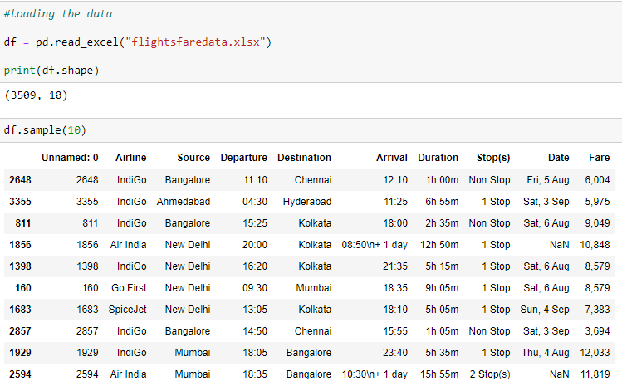
Dataset Information
Data is collected from www.yatra.com for timeframe of 04 August 2022 to 06 August 2022 and 01 September 2022 to 04 September using selenium and saved in CSV file.
Data is scrape for flights on routes like New Delhi to Mumbai, Mumbai to Bengaluru etc.
Data is scrap for Economy class. Around 3500 flights details are collected for this project.

Slide 6
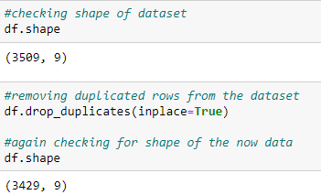
Data Pre-Processing and Visualization
The dataset is large and it may contain some data error. In order to reach clean, error free data some data cleaning & data pre-processing performed data.
The dataset is large and it may contain some data error. In order to reach clean, error free data some data cleaning & data pre-processing performed data.
Firstly data integrity was checked and duplicated data was removed.

Slide 7
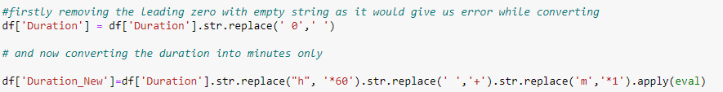


Conversion of Duration column from hour and minutes format into Minutes –
Creation of four new variables from Departure and Arrival variables –

Slide 8

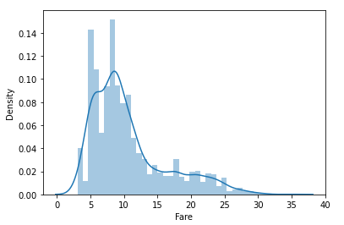
- Skewness can be seen in the data for flight fares - A few outliers can also be seen - Most of the flight fares are in range five to fifteen thousand
Conversion of Fare i.e. the target variable into numerical datatype –
Visualization
Fare – The Target variable:

Slide 9
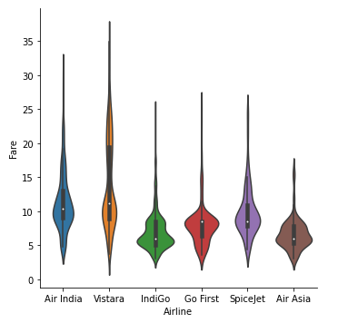
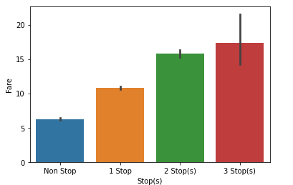
-Vistara airline has the highest - The flight fares are increasing average flight fares following with increasing in number of stops by Air India airline - More the stops higher the price -Air Asia has the cheapest average flight fare
Airline and Fare: Stops(s) and Fare:

Slide 10
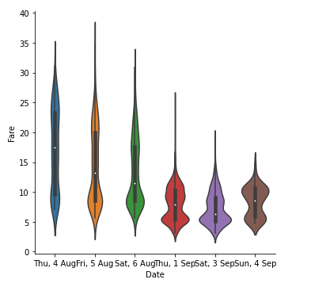
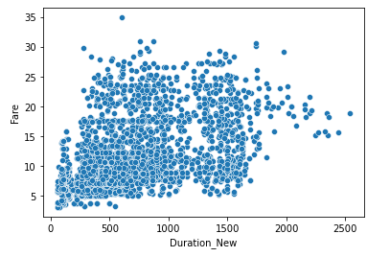
- It can be seen that current flight - It can be seen that long duration fares are much higher than flights have high fare as well the flight fares after a month - It can be seen that long duration flights have -A person should book tickets at least a high fare as well month before the date of booking for cheaper flight fares
Date and Fare: Duration and Fare:

Slide 11
Building Models
Before applying the algorithms data encoding has to be done for categorical variables.
Afterwards feature selection was done and the input data was scaled.
The different regression algorithm used in this project to build ML model are as below:
Linear Regression
Lasso Regression
Ridge Regression
K-Neighbors Regressor
Decision Tree Regressor
Random Forest Regressor
Ada Boost Regressor
Gradient Boosting Regressor
XGB Regressor

Slide 12
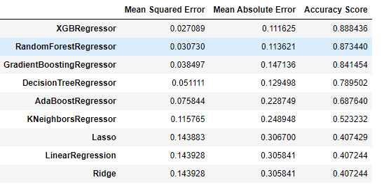
Best Model?
As we can see XGB Regressor is giving us the best results , with highest accuracy score and lowest errors.
Now one must check for cross validation score as well. Afterwards hyperparameter tuning is done for more accurate results.

Slide 13
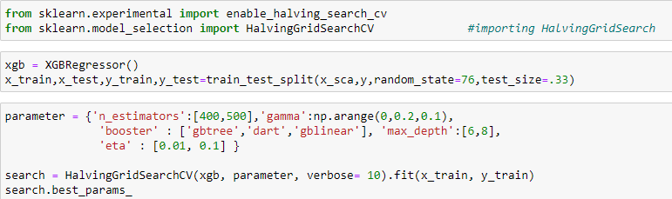
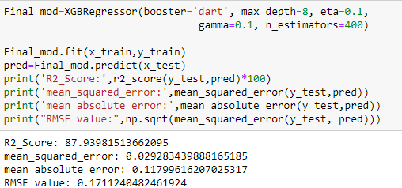
Below is the code for hyperparameter tuning using Halving Grid Search CV:
Training the model with optimum value of parameters and checking for accuracy score and metrics.

Slide 14
Limitations and Future scope
In this study we focus on flights on a few routes only, more route can incorporate in this project to extend it beyond present investigation.
This investigation focus on short timeframe which is 3 days from current booking date to 3 days of next month which can be extended variation over larger period.
Time series analysis can be performed over this model.
A much more extensive hyperparameter tuning and feature engineering can also produce better results.

